Slide 1

15IT304J-WEB
PROGRAMMING

Slide 2
RA1711003011161-SRINIVASA SRIKRISHNA JOSHI RA1711003011203-PARAS
COLLEGE MANAGEMENT SYSTEM

Slide 3
INTRODUCTION
This is a web-related application that permits us to approach the entire knowledge regarding the college, employees, students, faculties etc. This application is also called as institute management system. It offers an actual trip of the college campus. Here we would gain the recent knowledge regarding the students and employees.
This general application planned for aiding the students of an organization about details on the courses, subjects, classes, assignments, grades and time-table. It also allows the faculty to know his time-table, upload assignments and issue circulars to the pupil.
The administrator would maintain the accounts of the pupil and staff, prepares the time-table and upload the current information regarding the campus.

Slide 4
System Requirements:
Hardware:
Desktop/Laptop
I3 processor
2gb RAM
Internet
Software:
Xamp/Tomcat
Browser(ie chrome)
Text Editor
MySQL

Slide 5
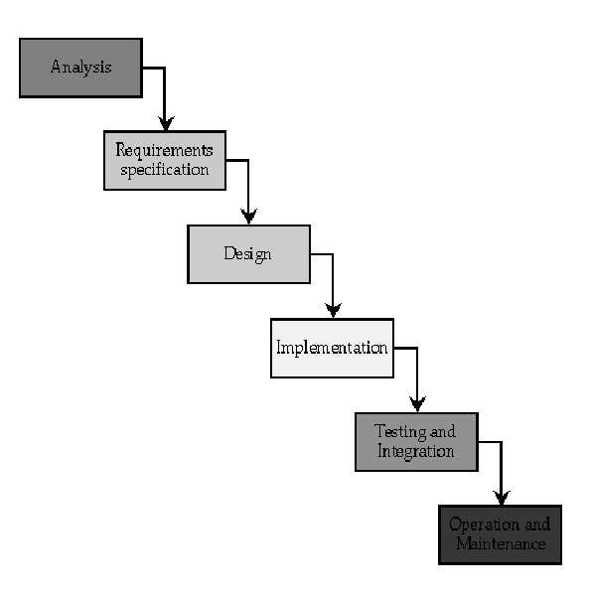
System Architecture

Slide 6
Implementation:
<?php
error_reporting(E_ERROR | E_WARNING | E_PARSE);
$currDir = dirname(__FILE__);
include("{$currDir}/defaultLang.php");
include("{$currDir}/language.php");
include("{$currDir}/lib.php");
$x = new DataList;
$x->TableTitle = $Translation['homepage'];
$tablesPerRow = 2;
$arrTables = getTableList();
// according to provided GET parameters, either log out, show login form (possibly with a failed login message), or show homepage
if(isset($_GET['signOut'])){
logOutUser();
redirect("index.php?signIn=1");
}elseif(isset($_GET['loginFailed']) || isset($_GET['signIn'])){
if(!headers_sent() && isset($_GET['loginFailed'])) header('HTTP/1.0 403 Forbidden');
include("{$currDir}/login.php");
}else{
include("{$currDir}/header-user.php");
}

Slide 7
<?php $currDir=dirname(__FILE__); include("$currDir/defaultLang.php"); include("$currDir/language.php"); include("$currDir/lib.php"); handle_maintenance(); header('Content-type: text/javascript; charset=' . datalist_db_encoding); $table_perms = getTablePermissions('parents'); if(!$table_perms[0]){ die('// Access denied!'); } $mfk=$_GET['mfk']; $id=makeSafe($_GET['id']); $rnd1=intval($_GET['rnd1']); if(!$rnd1) $rnd1=''; if(!$mfk){ die('// No js code available!'); } switch($mfk){ } ?>

Slide 8
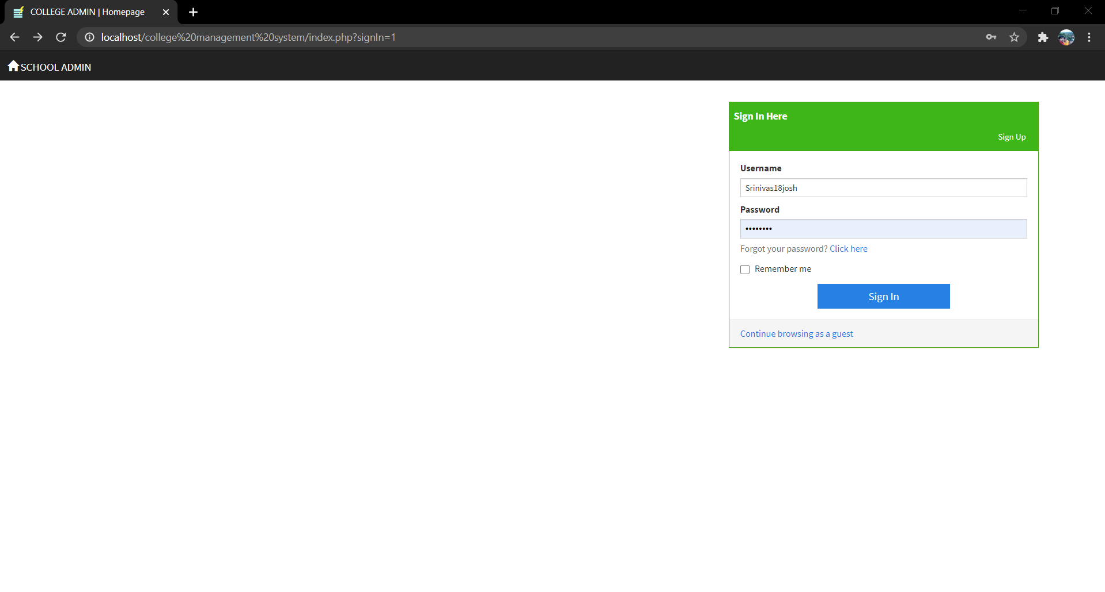
Screenshots

Slide 9
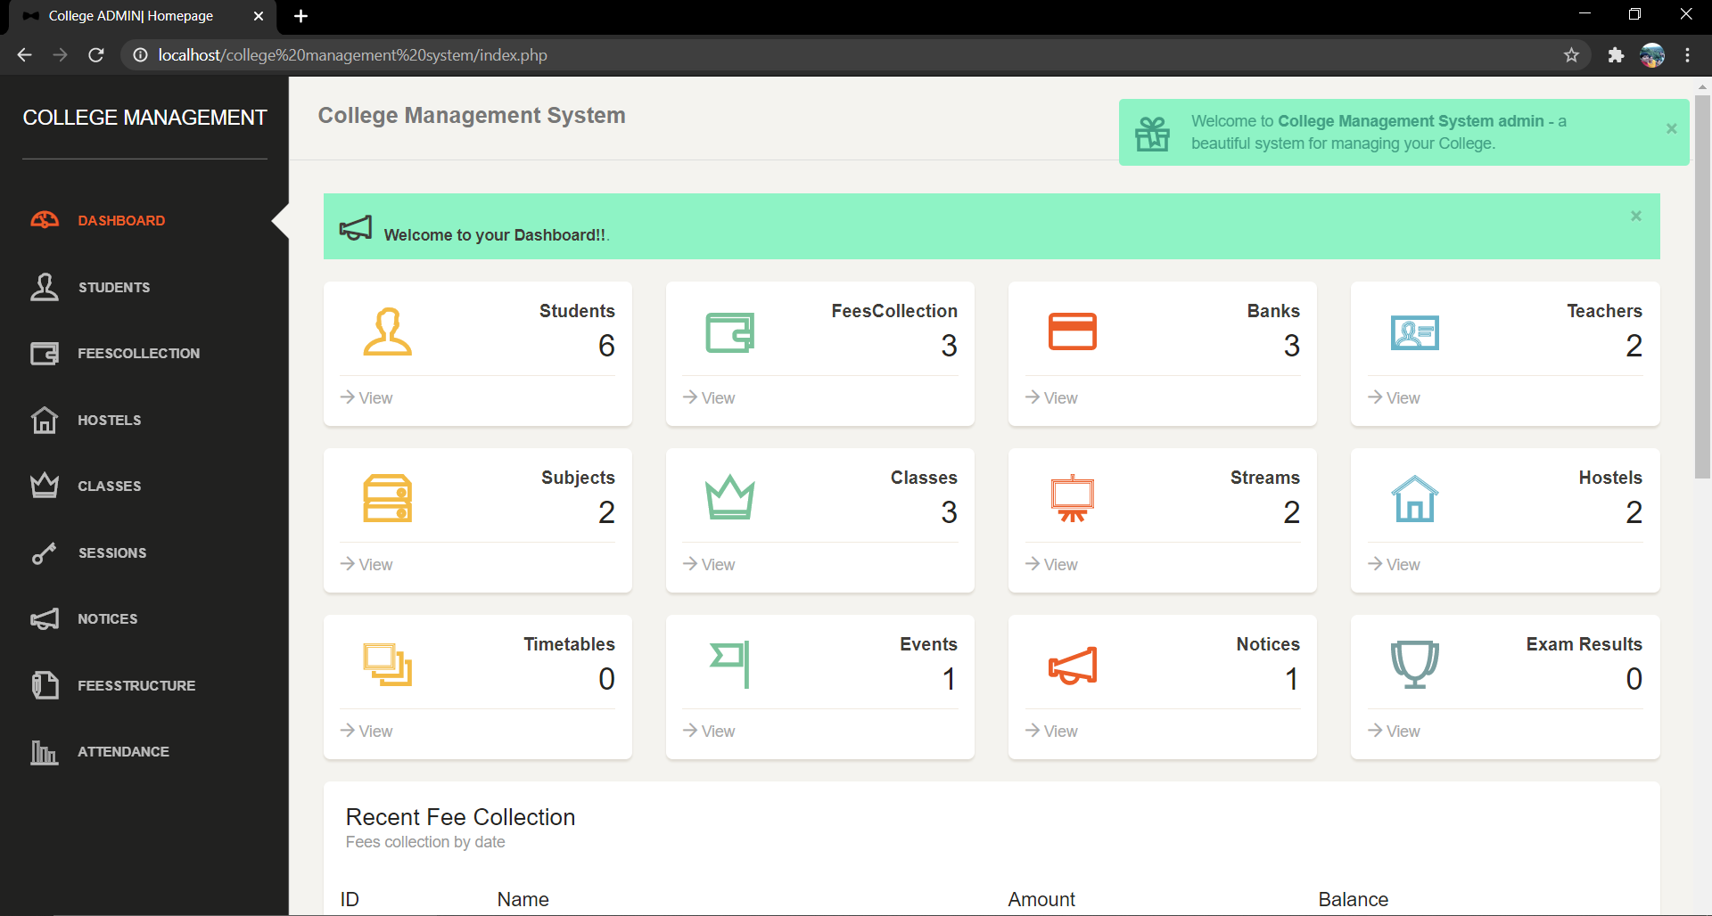

Slide 10
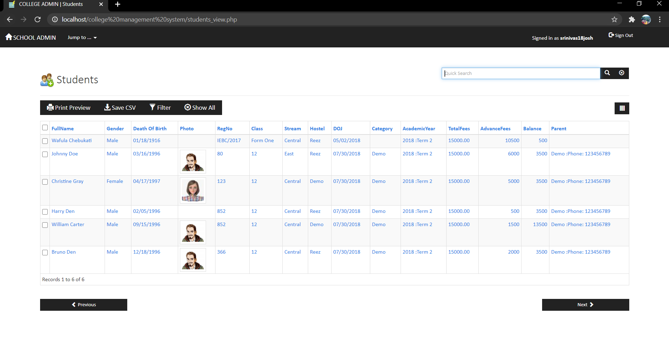

Slide 11
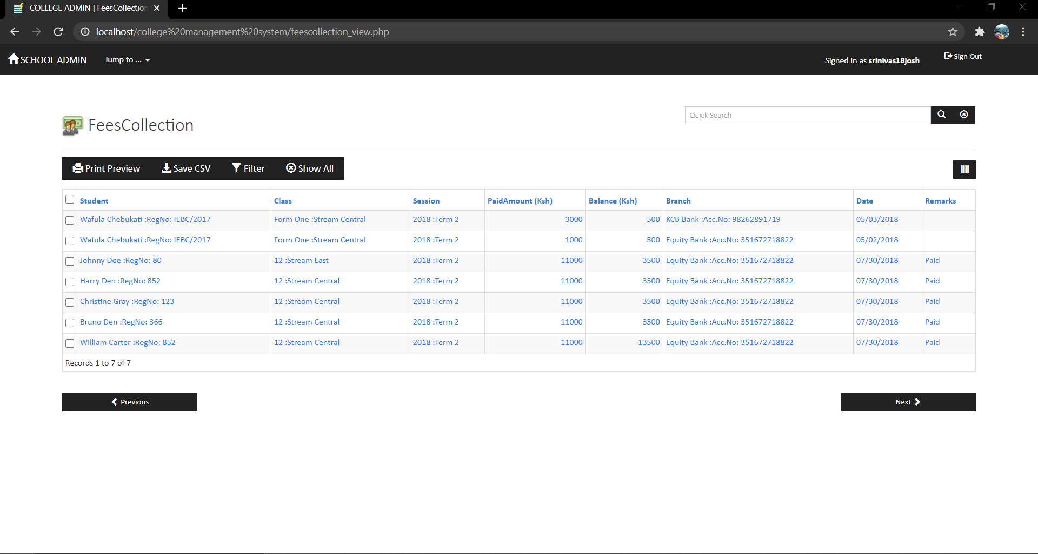

Slide 12
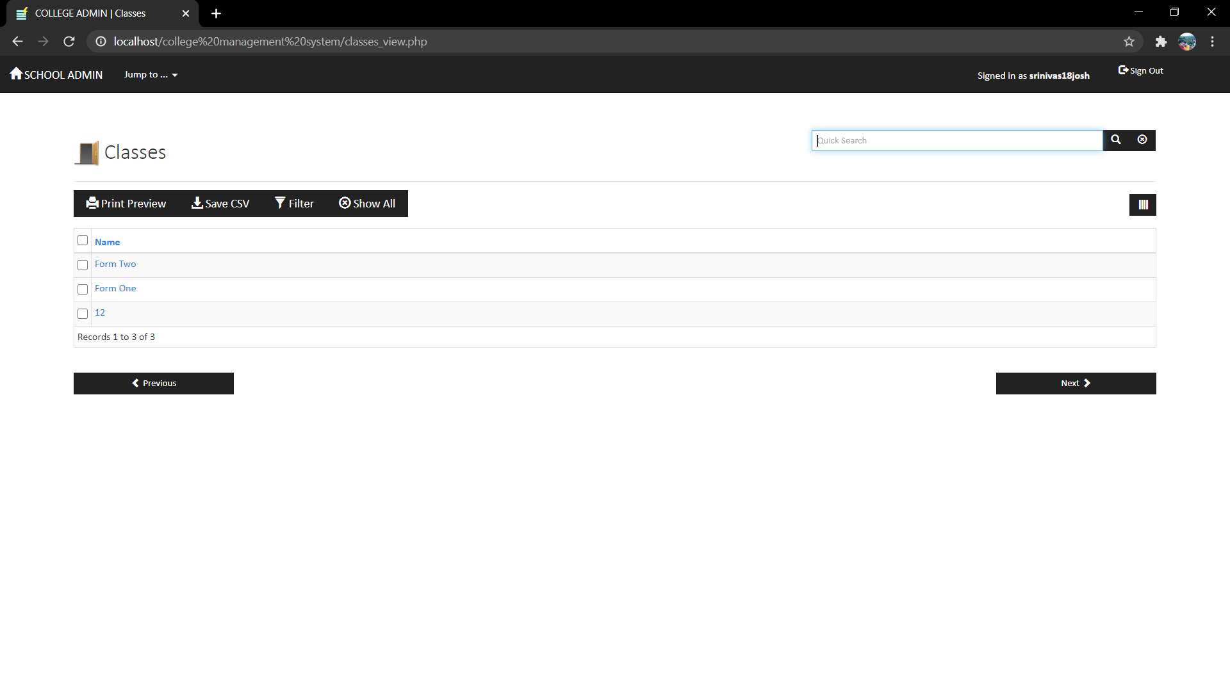

Slide 13
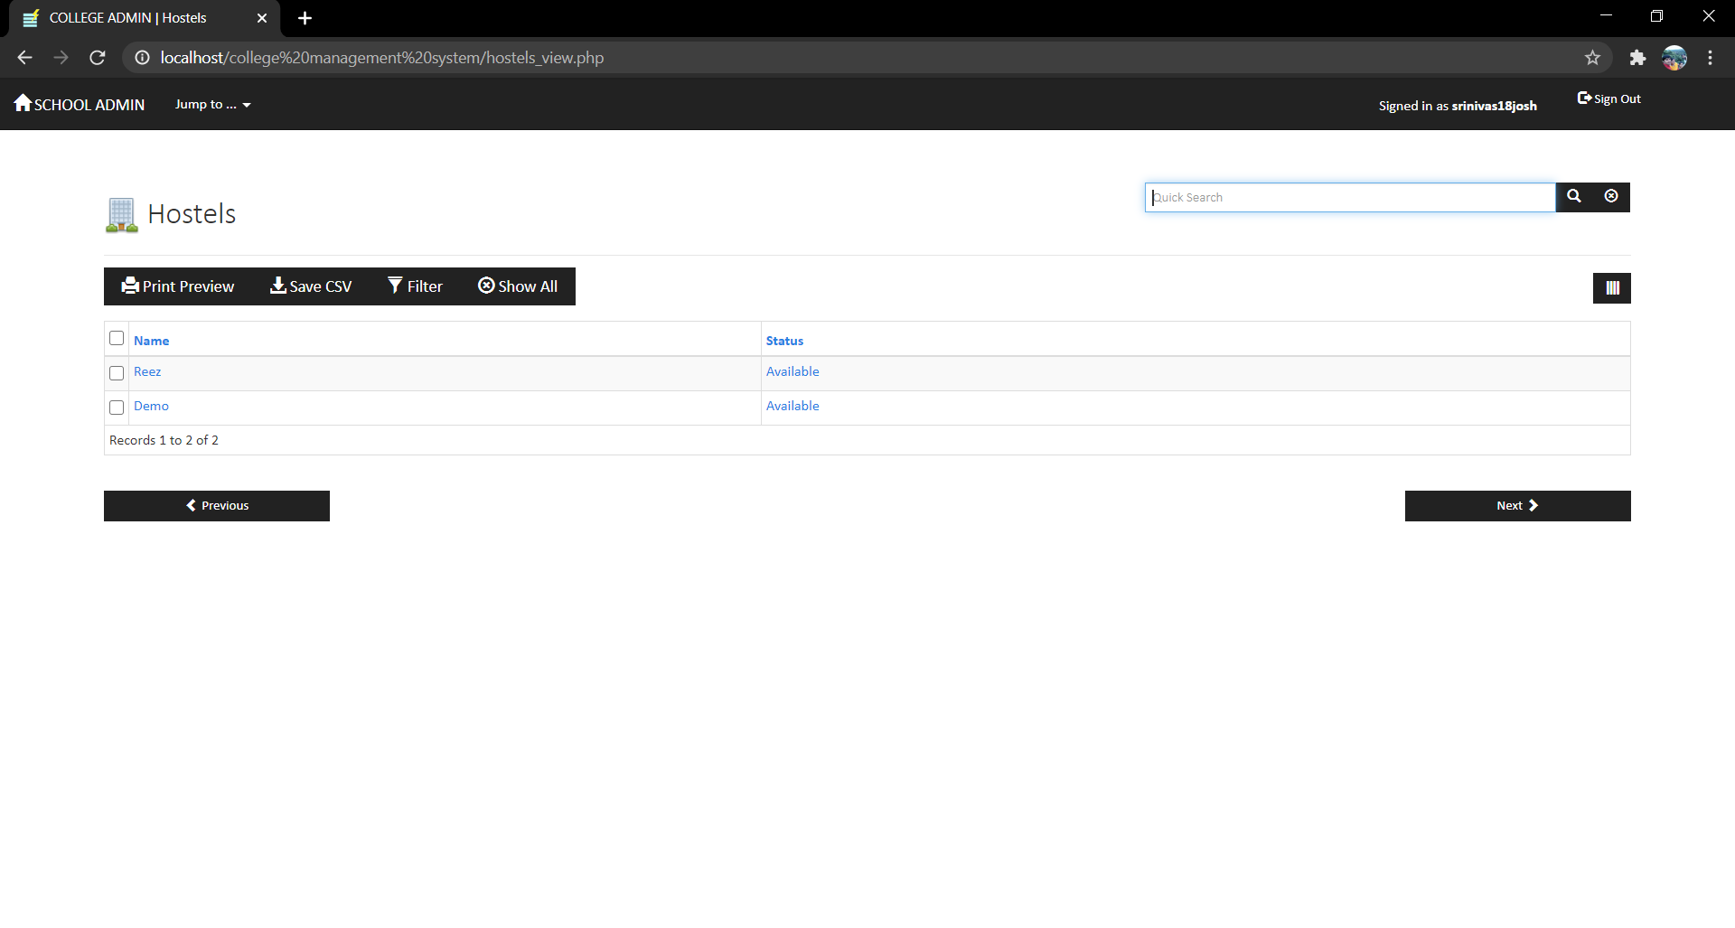

Slide 14
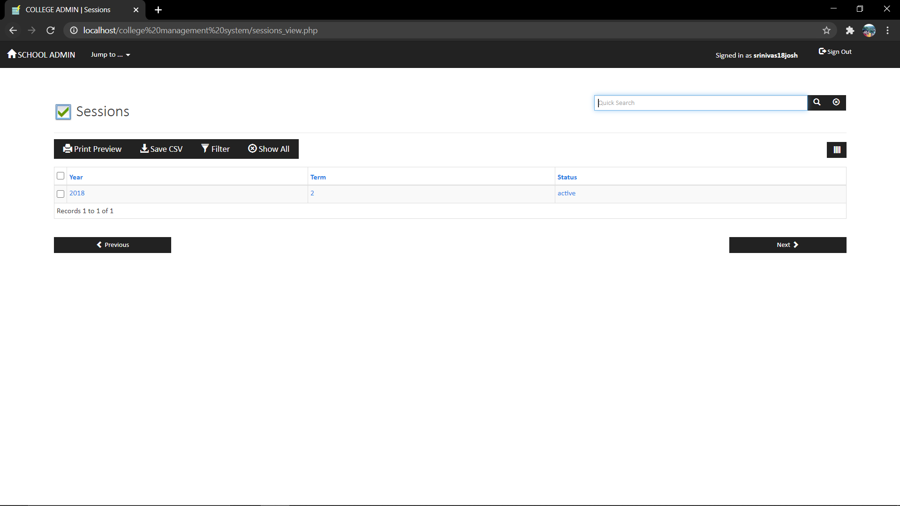

Slide 15
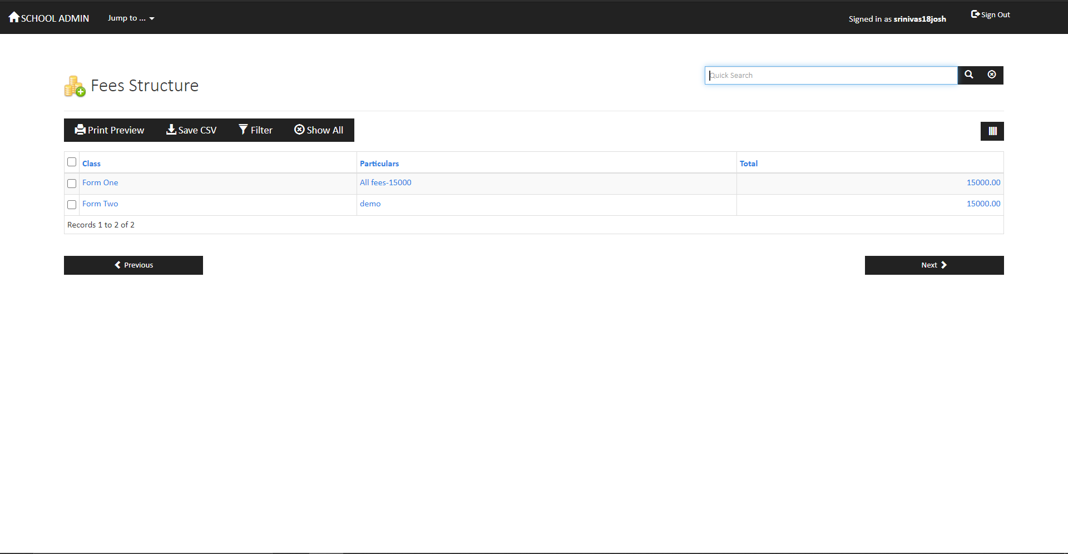

Slide 16
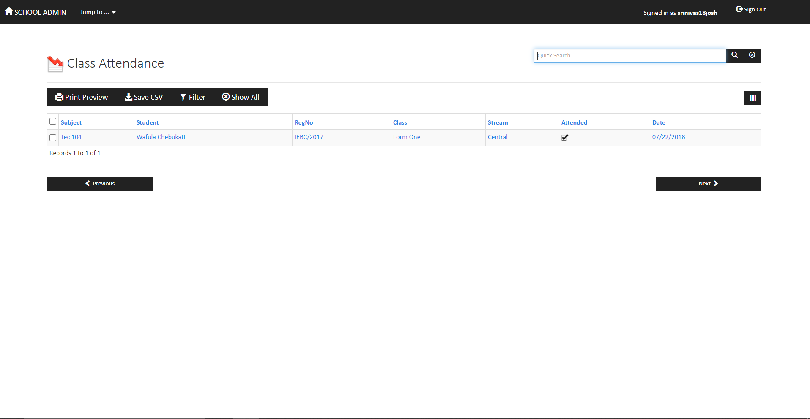

Slide 17
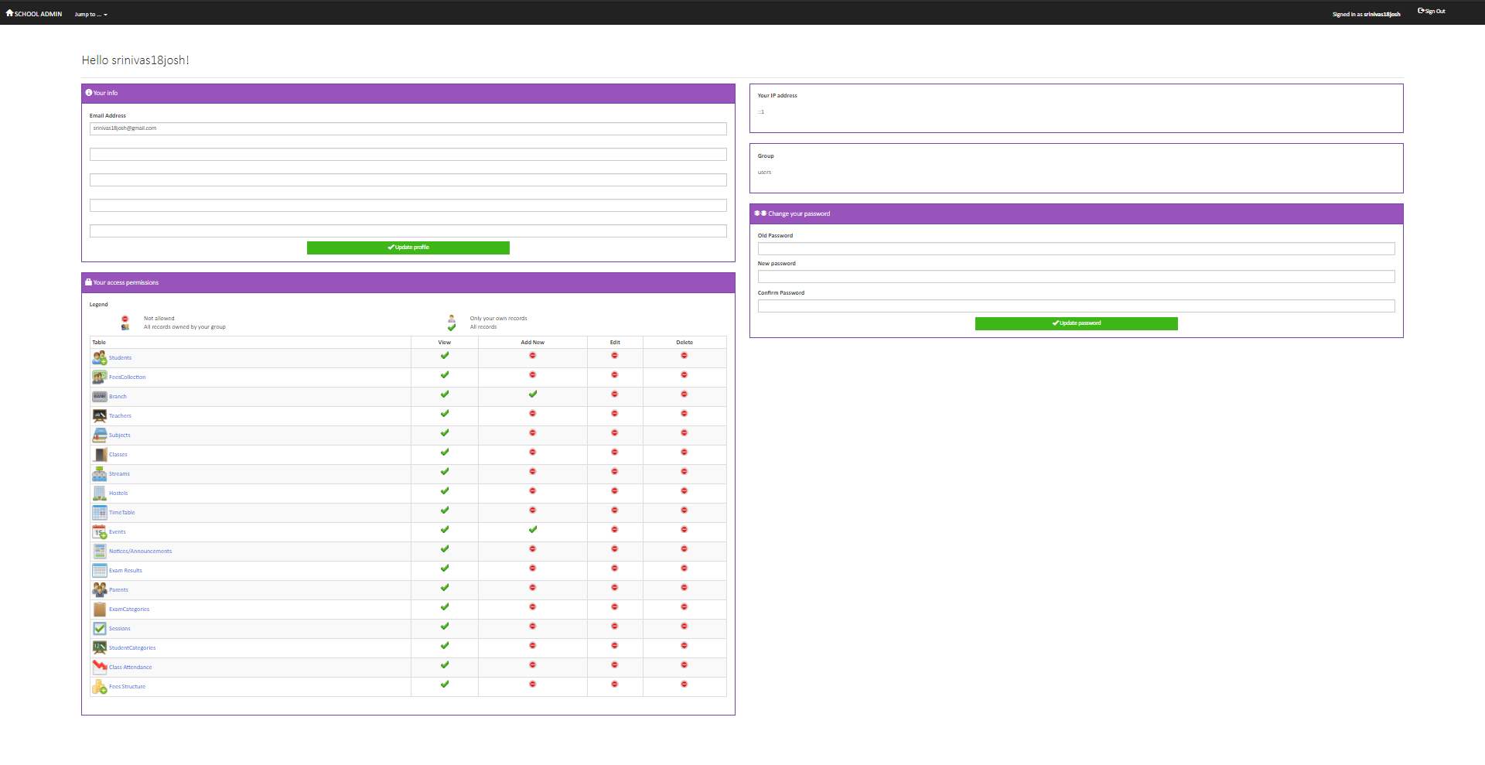

Slide 18
Conclusion:
The project entitled as College Management System is the system that deals with the issues related to a particular institution. This project is successfully implemented with all the features mentioned in system requirements specification. Awareness and right information about any college is essential for both the development of student as well as faculty. So this serves the right purpose in achieving the desired requirements of both the communities.

Slide 19
Future Scope:
The JSR-82 is the student information management system official Java API for Bluetooth wireless technology. Using this API you can create applications that perform any of the university project java source code following functions:
1. Determine and inspect the management system developed in java properties of your own Bluetooth device
2. Discover Bluetooth devices within the college books communication range of your device
3. Search for services on remote Bluetooth devices
4. Create Bluetooth client applications that can communicate with remote Bluetooth servers
5. Create Bluetooth server applications that can service requests from Bluetooth clients
The JSR-82 consists of two packages, javax.bluetooth and javax.obex. Your own Bluetooth device is represented by the free download college management system project in php javax.bluetooth.LocalDevice class and all remote Bluetooth devices are represented by the free download college management system project in php javax.bluetooth.RemoteDevice class.

Slide 20
Bibilography:
[1] Zhibing Liu, Huixia Wang,Hui Zan “Design and implementation of online college management system.” 2010 International symposium on intelligence information processing and trusted computing. 978-0-7695- 4196-9/10 IEEE.
[2] Zhi-gang YUE, You-wei JIN, “The development and design of the student management system based on the network environment”, 2010 International Conference on Multimedia Communications, 978-0-7695-4136- 5/10 2010 IEEE.
[3] TANG Yu-fang, ZHANG Yong-sheng, ,“Design and implementation of college student information management system based on the web services”. Natural Science Foundation of Shandong Province(Y2008G22), 978-1-4244-3930-0/09 2009 IEEE.
[4] M.A. Norasiah and A. Norhayati. “Intelligent student information system”. 4th International conference on telecommunication technology proceedings, Shah Alam, Malaysia, 0-7803-7773-7/03 2003 IEEE.
[5] Jin Mei-shan1 Qiu Chang-li 2 Li Jing 3. “The Designment of student information management system based on B/S architecture”. 978-1-4577-1415-3/12 2012 IEEE.

Slide 21
Thank You

